Slide 1

Welcome and logistics
4-8 November 2024, ESAC, Spain

Slide 2
Welcome!
Welcome to ESAC, ESA’s centre for science operations planning, data science and archiving
please keep your badges visible throughout the workshop
The primary aims of this workshop are to:
introduce the PDS4 standard, and its use in the ESA Planetary Science Archive (PSA),
show you how to produce and validate PDS4 data products,
get hands-on experience and feedback and
answers your questions!
We have a diverse range of participants with different levels of experience
sorry in advance if something is too simple, or too complex!
We have “free time” on Friday morning for splinters, further hands-on and mission/team-specific topics
please let us know now, or during the week, if you have topics for this session
If not, we will be available for further free discussion, Q&A, tutorials etc.
so far we have prepared an xpath and Schematron presentation

Slide 3
Logistics
WiFi
EduRoam is available, otherwise please collect a login sheet from the front of the room
Refreshments
There are morning and afternoon coffee breaks
Water is available in the room
If you need a caffeine hit outside the breaks, there is a coffee machine in the D-building foyer
Toilets
At the front of the D-building – follow the signs
Lunch
starting tommorrow, each day at 13:30 in the canteen, at your own cost (complete menu is approx. €11)
cash and credit cards are accepted
daily menu: https://esa.appleona.es/menu
Cocktail reception
Tuesday evening at end of session – the bus back to Madrid will depart at 19:30

Slide 4
Online participation, Q&A
Presentations and important links are available from the workshops programme page
https://www.cosmos.esa.int/web/pds4-workshop/
We are offering online participation via Microsoft Teams
see the programme for the link, or your email
feel free to join also if you are in the room!
but mute your mic and turn down your speakers
The agenda is a rough guide only – we will try to answer questions as they come up
unless they are to be covered by a pending talk
If you have questions:
in the room – activate your mic before speaking
online - please raise your electronic hand, or post in the chat
or use the Q&A function in Teams
For the hands-on parts of the workshop in-person participants will be prioritised
but if you are following along online, please post if you have questions or issues and we will try to help!

Slide 5
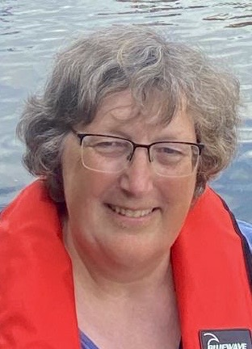
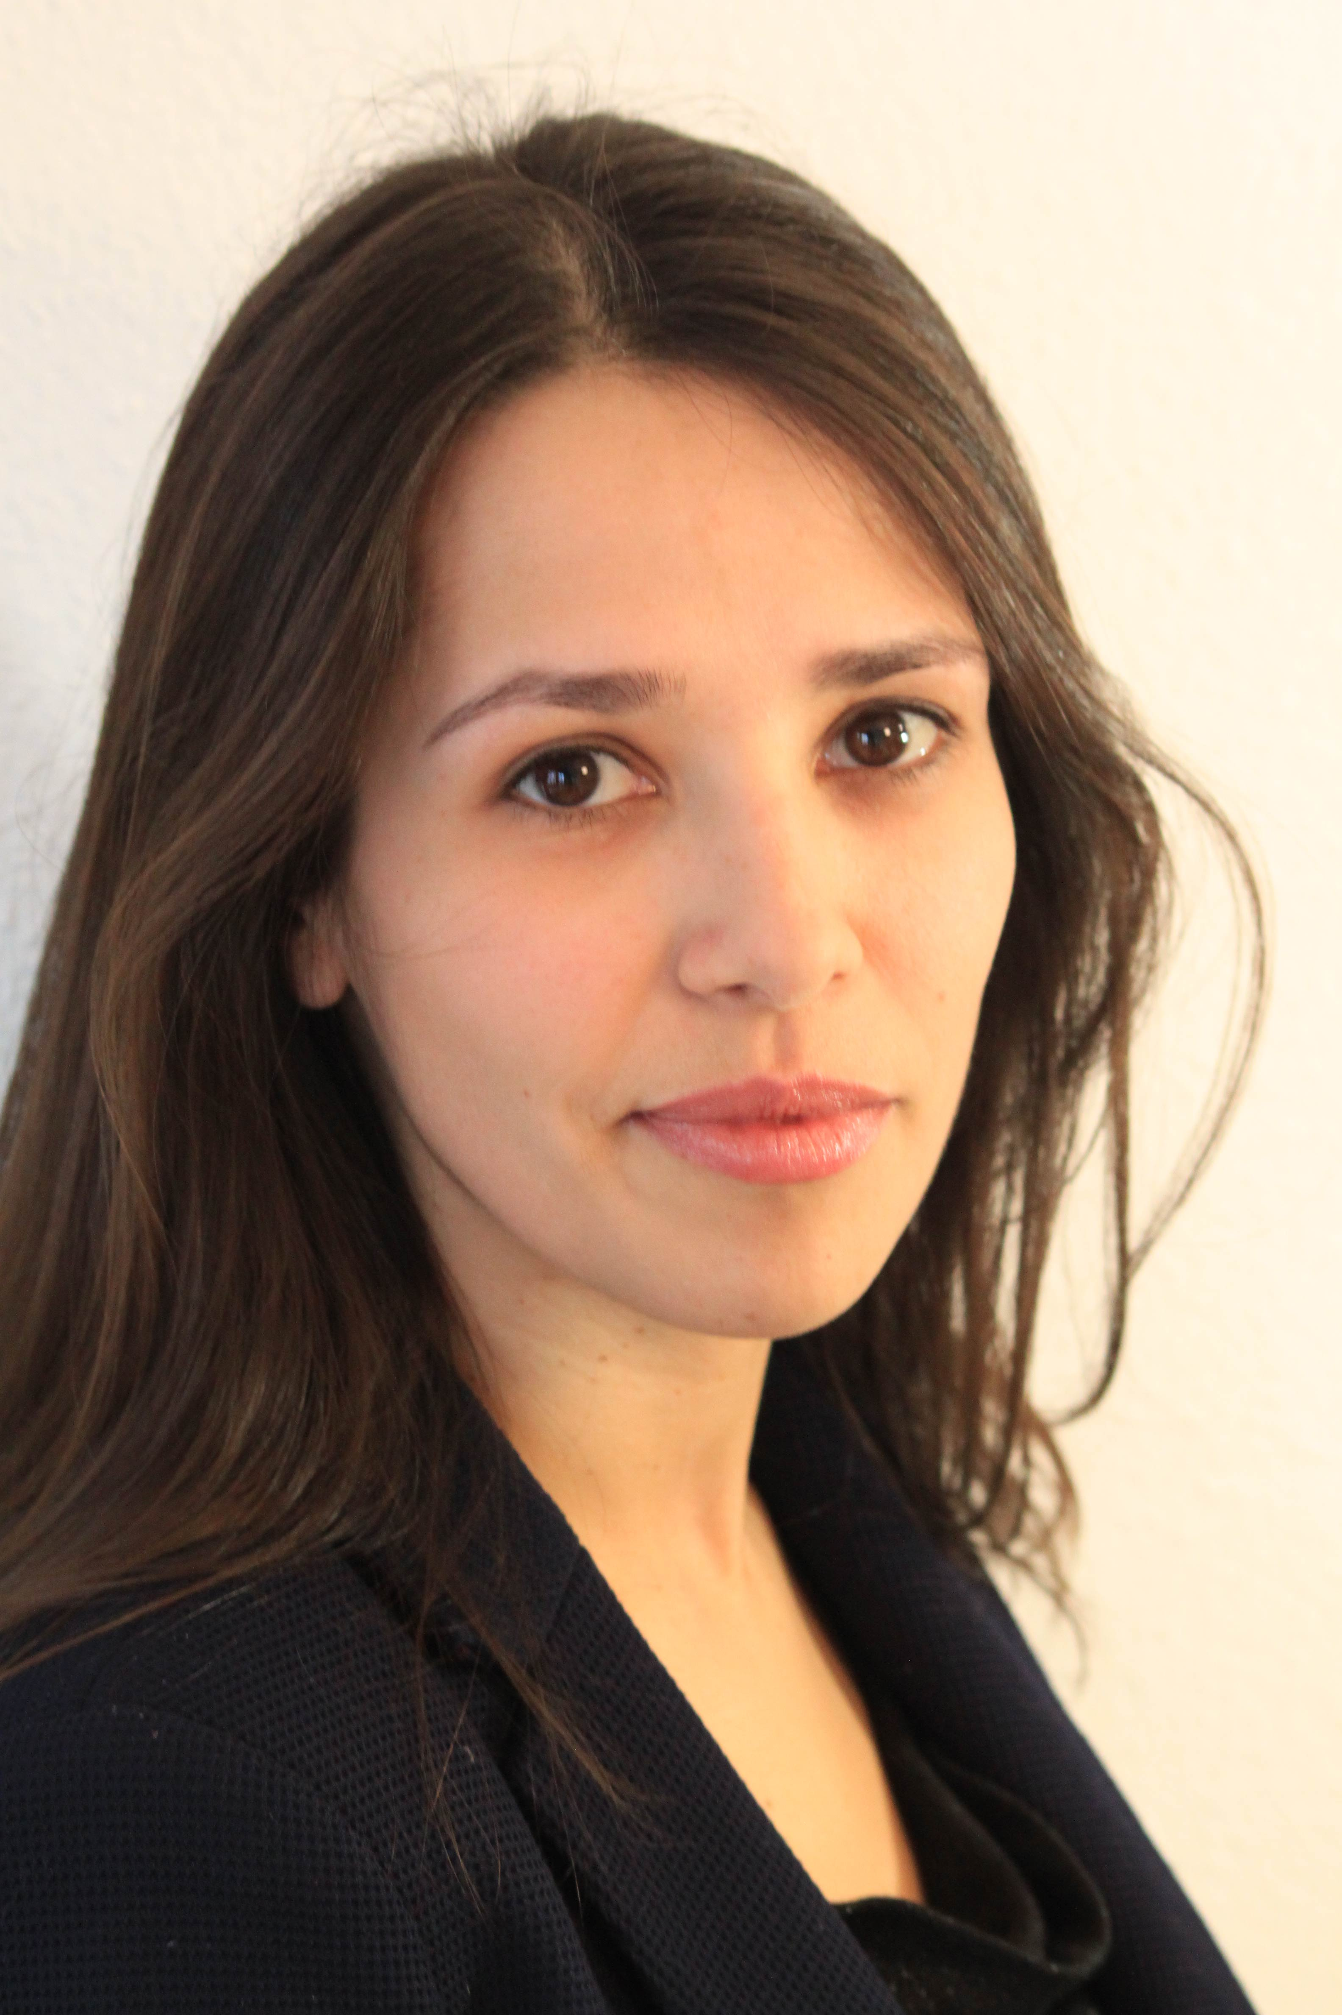
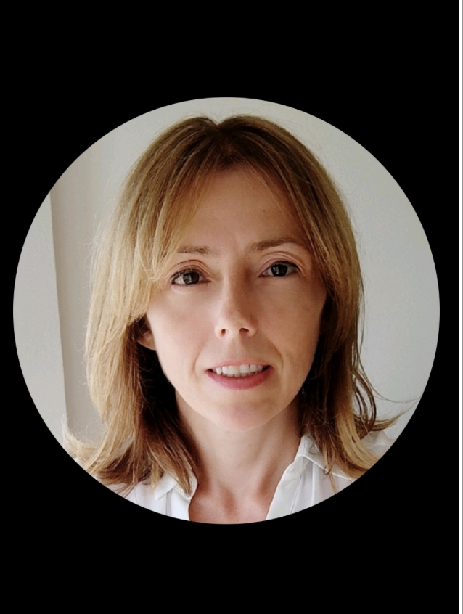
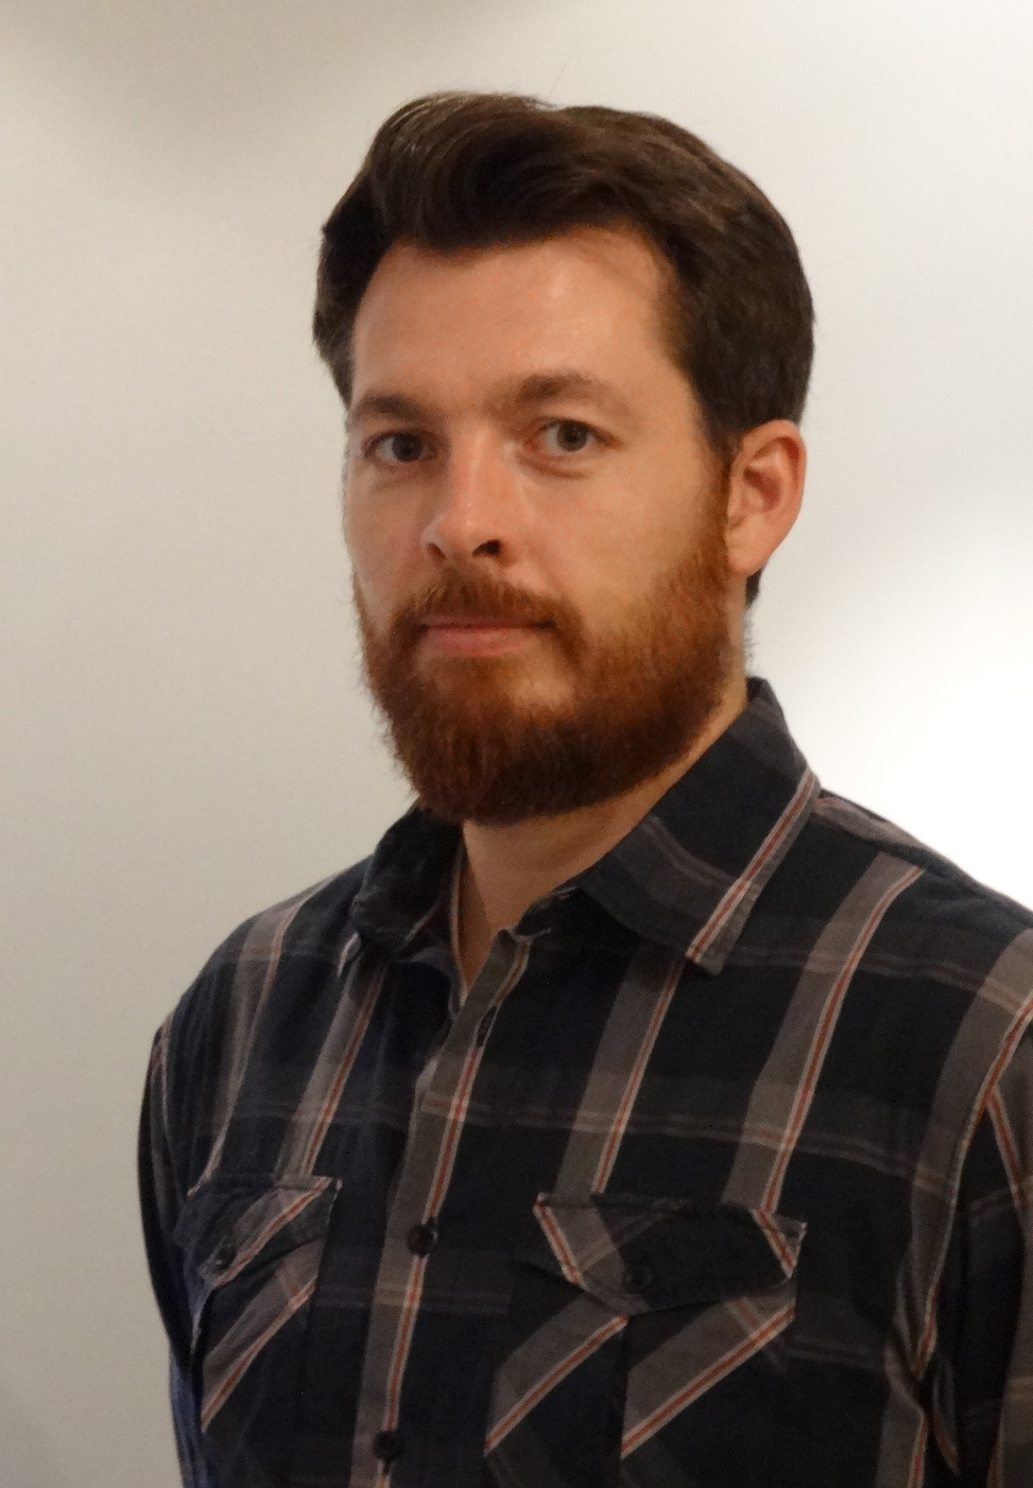
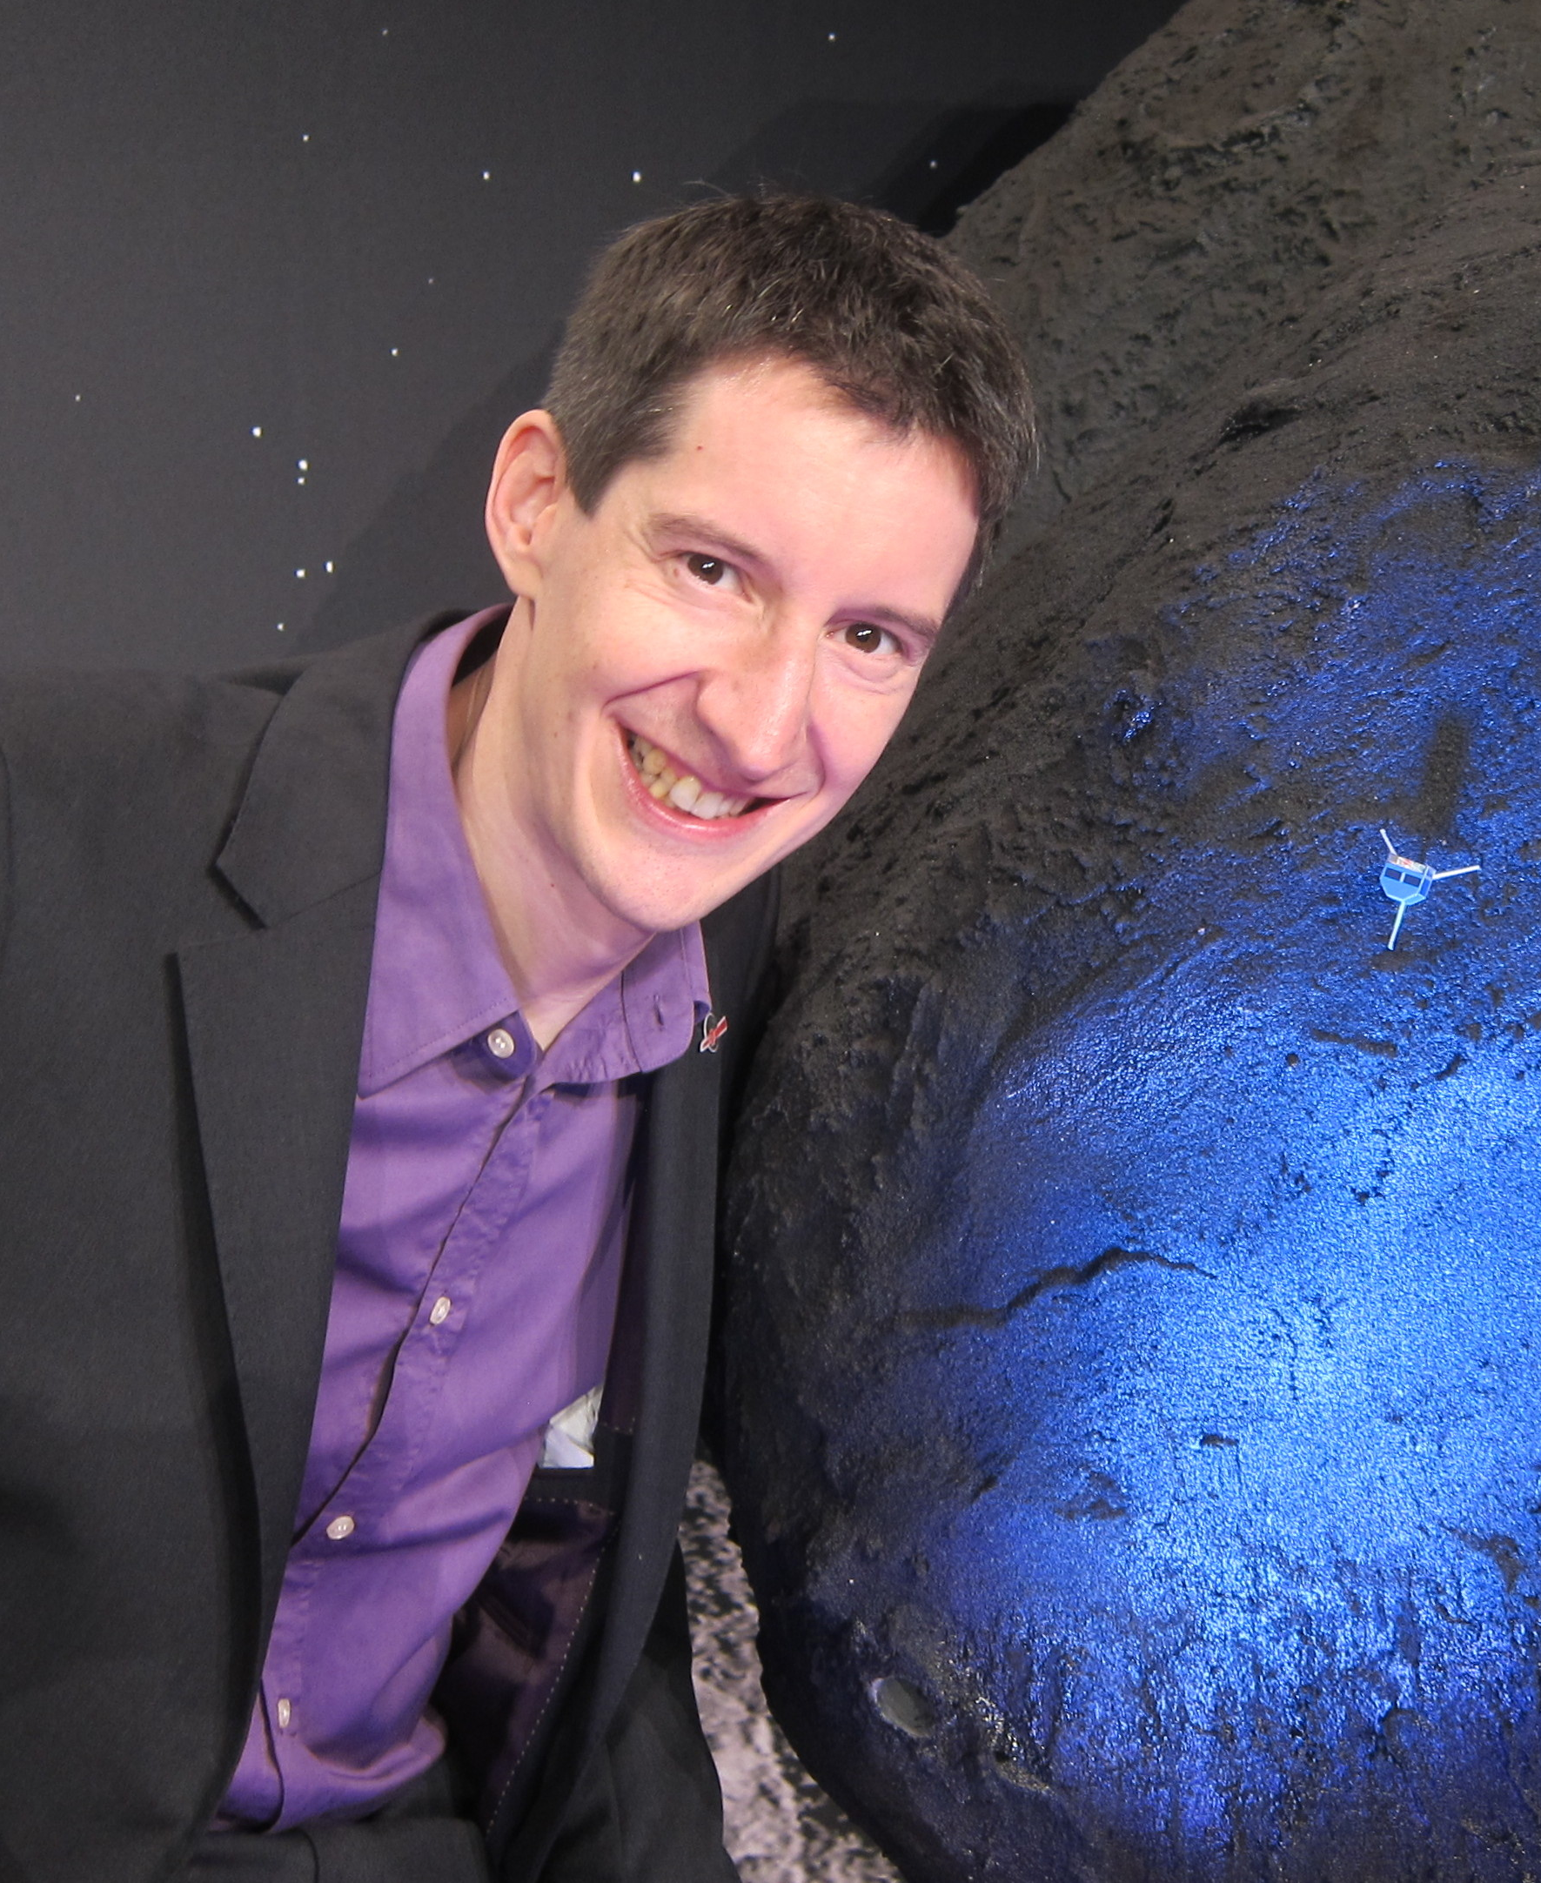
The workshop team
Helping you out this week will the archive scientists working on PDS4 at ESA
For active missions your archive scientists are:
TGO: Tanya
BepiColombo: Daniela and Mark
JUICE: Joana and Thomas
For future missions we will support you according to your needs
Tanya Lim
Joana Oliveria
Daniela Coia
Thomas Cornet
Mark Bentley

Slide 6

Last, but not least…
PDS4 archiving is not rocket science, but it can be… painful
Final materials presented here will be available after the workshop
including solutions to the hands-on exercises
If you have any doubts, ask your archive scientist
if you don’t have one… reach out and we will do our best to help!
You can reach us in a few ways:
PSA Helpdesk: https://support.cosmos.esa.int/psa/
OpenPlanetary Slack: https://openplanetary.slack.com/
or email
Further training materials are available from PDS at:
https://pds.nasa.gov/datastandards/training/
We will send a survey after the workshop
your feedback would be appreciated to improve the next one!

